Slide 1
Cucumber Testing 106 November 20, 2018 Cucumber / Serenity Automated Testing Overview and Demo

Slide 2
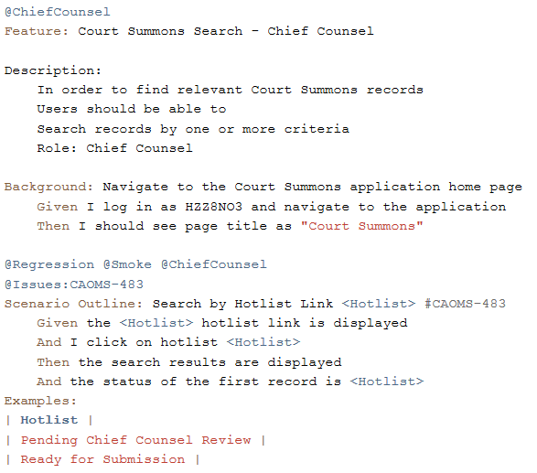
Cucumber Overview and Purpose
Cucumber is the #1 Behavior Driven Development (BDD) tool with 30 million downloads
Define and specify tests and test steps using natural language
Cucumber Benefits:
Single source of truth: Specifications, tests, and documentation are in the same document.
Living documentation: Because they’re automatically tested by Cucumber, your specifications are always up-to-date.
Customer focus: Cucumber helps business and IT collaborate to build a shared understanding of the business goals.

Slide 3




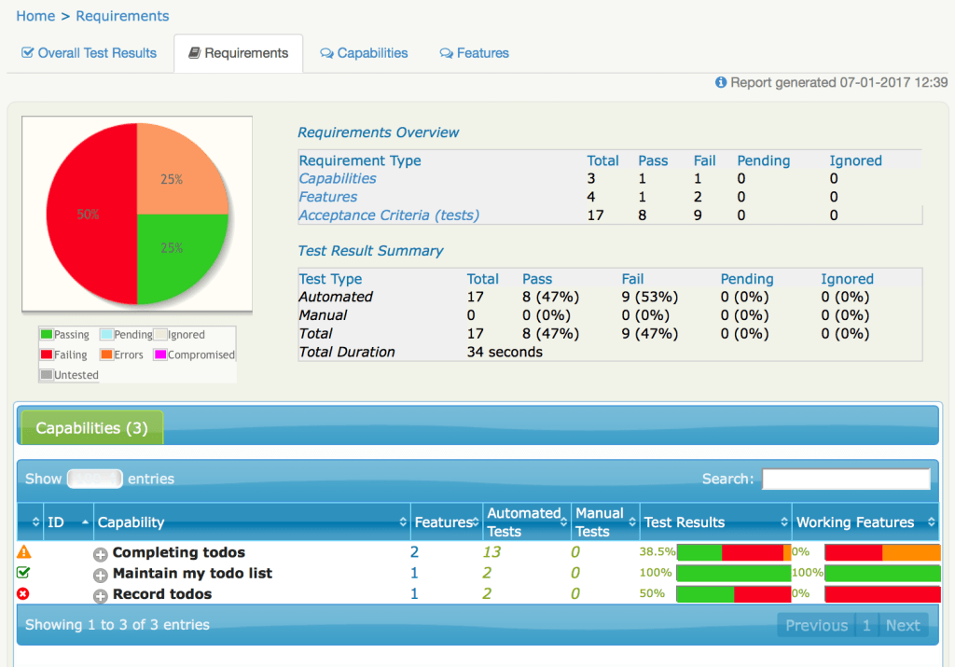


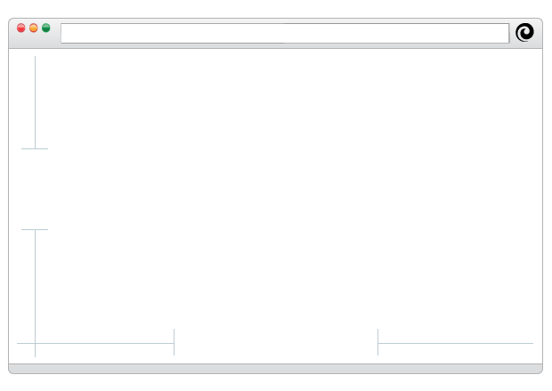
Cucumber / Serenity Workflow
Cucumber Feature File uses natural language, acts as an ‘executable specification’.
Scenario = Test Case
Feature Files constitute Test Inventory
User Stories
Acceptance Criteria
Feature: Application Login
Scenario: Successful Login Attempt
Given I am on the login page
When I enter the username and password
And click “Login”
Then I should see my profile page
Automation Tester defines each step in
Java and implements using Selenium.
(Cucumber/Serenity extends E2E RAP Framework)
Serenity Reports link to JIRA and support 2-way integration.
Bamboo Plan runs Cucumber Tests on VMs.
Cucumber Feature file is executed step by step.
011000
011101 01100011 01110101 01101101 01100010 01110010
MyStepDefinitions.java
Given_I_am_on_the_login_page()
When_I_enter_user_and_pass()
And_click_Login()
Then_I_should_see_my_profile()
Serenity records screenshots of each step
And aggregates results into an interactive report.
Step 1
Step 2
Step 3
Step 4
Notes:
Cucumber Feature can be defined as development is ongoing.
Ideally Acceptance Criteria in JIRA is defined in Gherkin syntax.

Slide 4



Cucumber / Serenity Technology Stack
Cucumber/Serenity extends the existing E2E RAP Framework.
Cucumber Feature Files written in plain English by capability owner, developer, tester and defines shared understanding of acceptance criteria.
Feature file is an ‘executable specification’ executed by Cucumber.
Serenity reports aggregate and visualize test results, contain screenshots of each step, remove the need to sift through test logs.
Custom driver created for Serenity to allow Cucumber to extend RAP Framework. JUnit @Class annotations ignored. *
Current Selenium Stack
New Cucumber Stack
RAP Framework
SRAP
Selenium
RAP Framework
Custom Report
Custom Driver *
Selenium
Cucumber
Serenity
JUnit
JUnit *
Notes:
Custom Driver is 95% SRAP with slight modification to allow Serenity to manage the WebDriver driver.

Slide 5
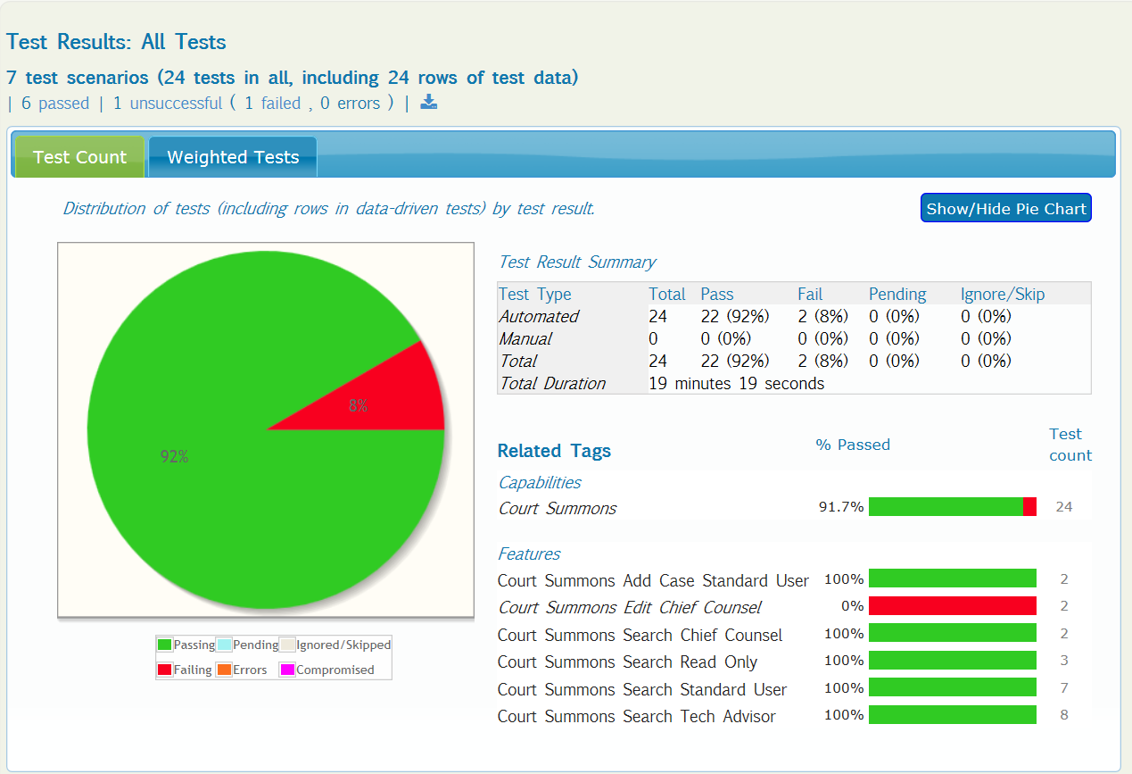
Court Summons Demo and Artifacts
Court Summons:
Serenity Report: Link
Feature Files: Link
Bamboo Plan: Link
Tools:
Cucumber.io: Link
Serenity: Link

